Slide 1

Asian Journal of Convergence in Technology
Early Prediction of Heart Disease Using the Most Significant Features of Diabetes by Machine Learning Techniques
AUTHORS:
Avijit Kumar Chaudhuri
Dr. Anirban Das
Dr. Deepankar Sinha
Dr. Dilip K. Banerjee
ISSN NO: 2350-1146 I.F-5.11

Slide 2

AGENDA :A
Discussing the uniqueness and correlation of Diabetes and Heart Disease
Data mining techniques in medical Analysis
Data sets
Choice of Models : Different supervised classifiers (DT,RF,LR)
Analyzing the data
Validation – K means Clustering
Conclusion

Slide 3

Discussing the uniqueness and correlation of Diabetes and Heart Disease
Among diabetic people, HD is the primary source of Death.
Evidence of increased incidence of hypertension and dyslipidemia associated with diabetes.
Studies show that instruments and other risk assessment algorithms are infrequently utilized in clinical
Practice to determine diabetes and HD’s simultaneous impact.
There is evidence identifying different factors that show the co-existence of diabetes and HD.
These factors include the individual’s Glucose Level In The blood, circulatory strain, cholesterol level (LDL), overweight, and tobacco use.
Analyzing the data
Validation – K means Clustering
Conclusion

Slide 4

Data mining techniques in medical Analysis
Data mining can be described as investigating veracity of patterns in data in a large dataset with different data-types.
These methods enable identification of characteristics, predict out comes and classify events.
Data mining techniques are useful in classifying, clustering, and finding associations amongst factors that are causes of a problem.
In health care, data mining techniques can be used to prevent suffering and mortality.
Data mining can be used in the insurance industry to prevent fraud and check accuracy and consistency in claims.
BENEFITS:
AI aids in automatic learning - resulting in faster diagnosis without involving the patients.
This aspect has benefits as it saves patients' time and predicts with higher accuracy.
Numerous variables and large data size is tackled using AI and data mining techniques that aid in classification, prediction and derive association rules.
Analyzing the data
Validation – K means Clustering
Conclusion

Slide 5
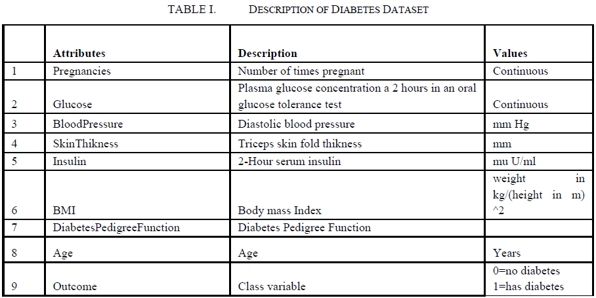
Data sets
DATASET 1: This dataset is used to predict whether a patient with diabetes is also likely to suffer from HD.
768 -> Patient records & 268 -> Patient records with Diabetes.
Analyzing the data
Validation – K means Clustering
Conclusion

Slide 6
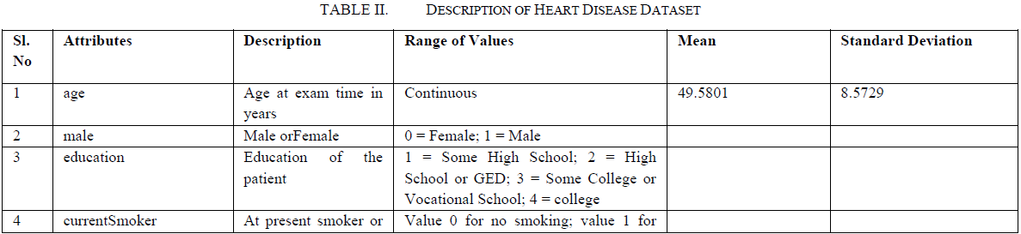
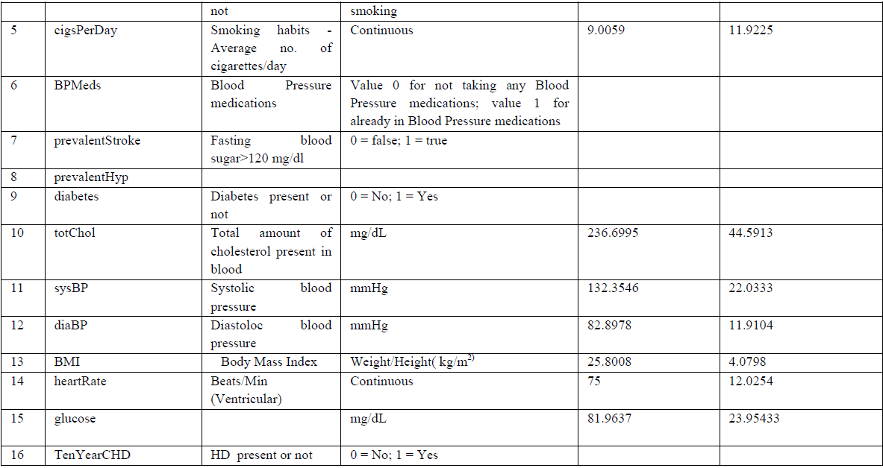
DATASET 2: Data associated with 4240 hospital patients was put to use for the HD analysis.
Analyzing the data
Validation – K means Clustering
Conclusion

Slide 7
Choice of Models : Different supervised classifiers (DT,RF,LR)
DECISION TREE (DT)
Filtration techniques are easy
Tree-like models > Decision support system.
Supervised classification : Extracting patterns and insights from set of independent inputs affecting the output variable.
Handle varied data – ordinal, nominal, ratio and text data.
Not affected by linearity in data, missing values, types of data, and outliers.
RANDOM FOREST (RF)
Ensemble approach.
Dataset is split into small sub-sets, and the decision tree algorithm is run on these sets.
Sampled with replacement.
Importance of feature obtained by Bootstrapping.
Reduces the variances without affecting complete ensemble’s bias.
Reduces Overfitting.
LOGISTIC REGRESSION (LR)
Predicting a disease outcome
Useful technique for determining the extent of individual features' impact on diseases occurrence or non-occurrence.
Analyzing the data
Validation – K means Clustering
Conclusion

Slide 8
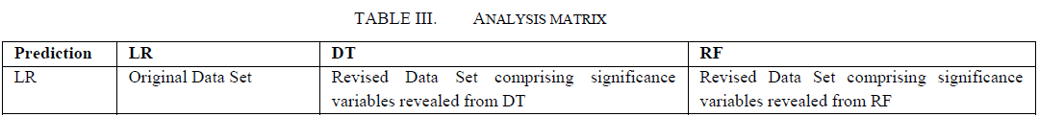
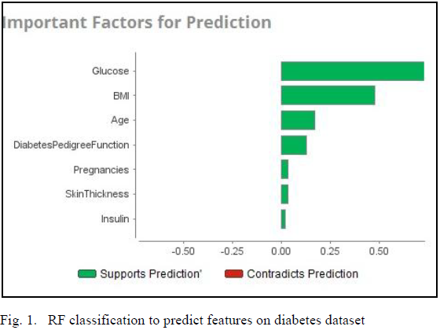
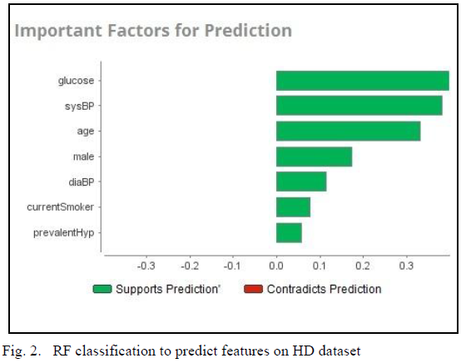
Analyzing the data
The dataset with important variables were put in LR to predict the presence of diabetes and HD
RF analysis For Diabetes disease dataset
RF analysis For Heart disease dataset
Analyzing the data
Validation – K means Clustering
Conclusion

Slide 9
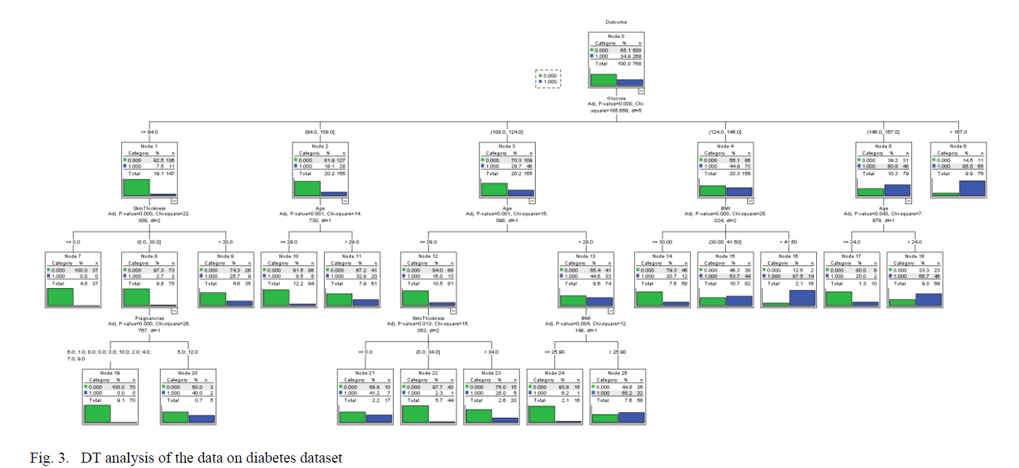
DT analysis of Diabetes disease dataset
Analyzing the data
Validation – K means Clustering
Conclusion

Slide 10
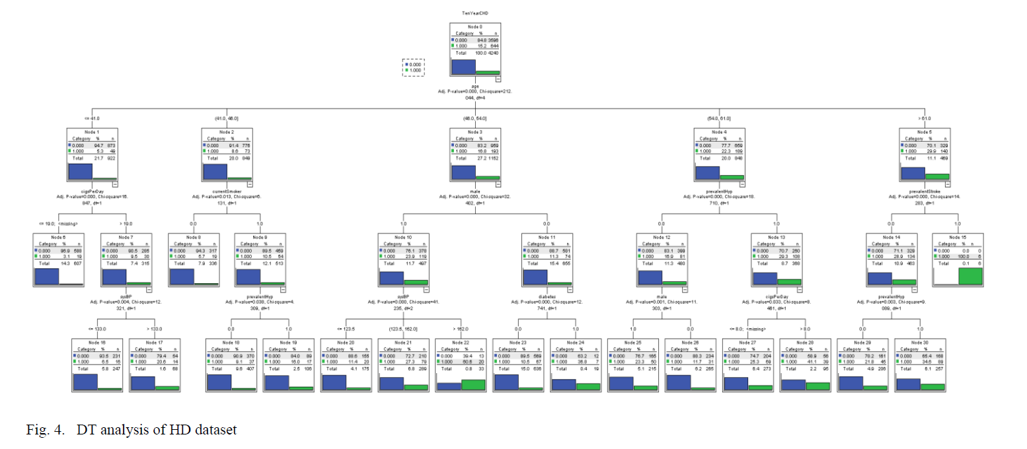
DT analysis of Heart disease dataset
Analyzing the data
Validation – K means Clustering
Conclusion

Slide 11
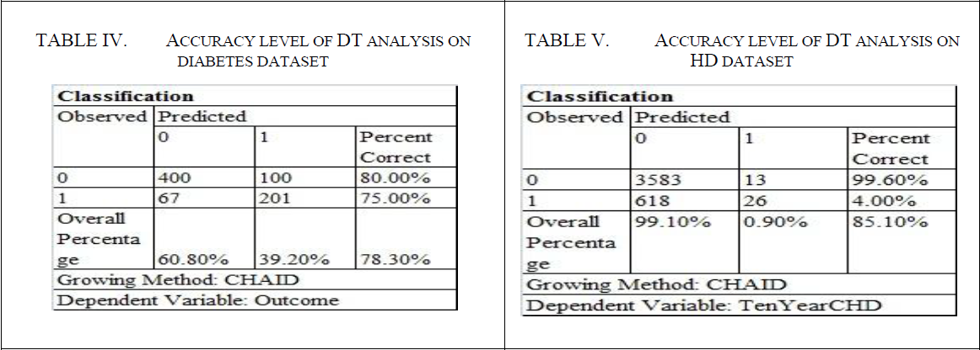
TABLE IV:
DT analysis of all factors predicts diabetes with 78.30 % accuracy.
Important factors : Glucose accompanied by SkinThickness, Pregnancies, Age and BMI (nearly same as shown by RF)
This did not include the BP as it is crucial for predicting HD.
Hence BP is not the cause for diabetes.
Reverse can be checked in table V.
TABLE V:
DT study of all variables predicts HD with an accuracy of 85.1%.
Important Factors : Age followed by cigsPerDay, currentSmoker, male, prevalentHyp, prevalentStroke, sysBP, and diabetes are significant for HD (same as shown by RF).
Includes diabetes as a significant variable.
Diabetes caused HD in 31% of the patients.
Analyzing the data
Validation – K means Clustering
Conclusion

Slide 12
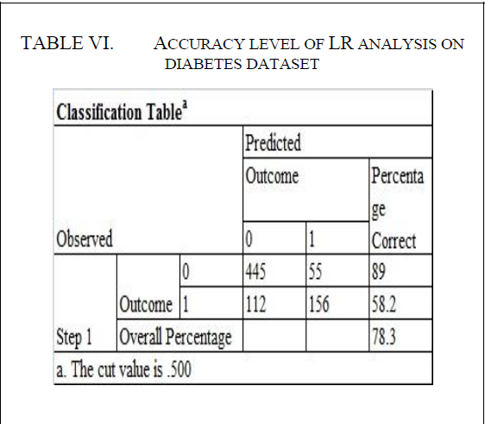
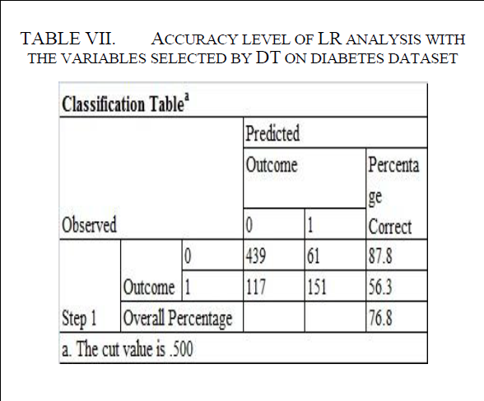
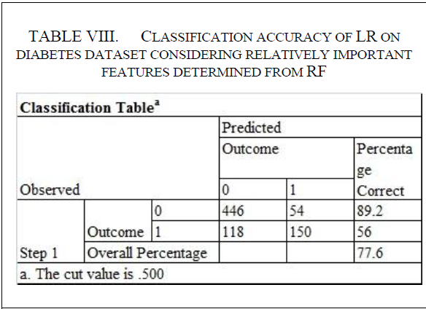
LR classification of Diabetes dataset considering all features
TABLE VI:
LR analysis of all features reveals that the variables Pregnancies, Glucose, BloodPressure, BMI and DiabetesPedigreeFunction are important together with the constant that predicts the existence of diabetes.
TABLE VII:
LR on characteristics considered to be important using DT shows that, along with the constant, Glucose, Pregnancies and BMI are statistically relevant and predict the existence of diabetes.
Overall accuracy of 76.8% which is less than analysis with DT.
TABLE VIII:
Glucose, BMI, DiabetesPedigreeFunction and Pregnancies, along with the constant, are statistically important and estimate the presence of Diabetes in the LR classification of the variable considered significant using RF.
Accuracy is lower than DT.
Analyzing the data
Validation – K means Clustering
Conclusion

Slide 13
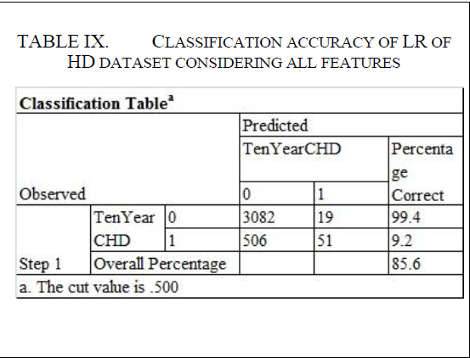
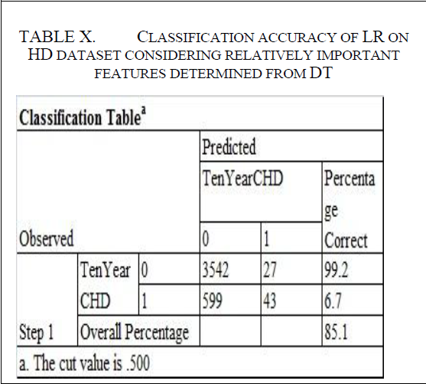
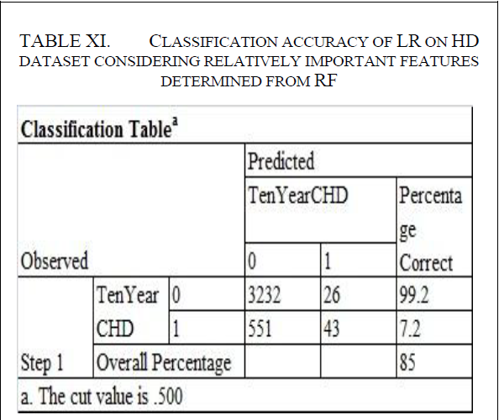
LR classification of HD dataset considering all features
TABLE IX:
The LR classification for all variables indicates that age, cigsPerDay, male, prevalent Stroke, sysBP, and diabetes are statistically relevant and predicted HD along with the constant.
LR analysis thus showed better accuracy in predicting the presence of HD on the dataset with the variables selected by DT analysis.
TABLE X:
LR showed similar results compared to DT in terms of overall accuracy (of 85.1%). But the accuracy of the presence of HD in this method is greater than the DT analysis of all variables (4.0 % ).
Outcome showed that use of important variables predicted by DT, in LR, has improved the findings.
TABLE XI:
Using the RF method shows that, along with the constant, glucose, sysBP, age, male and currentSmoker are statistically significant and predict the presence of HD.
Predicting the existence of HD, LR on the dataset with all variables demonstrated greater accuracy.
Analyzing the data
Validation – K means Clustering
Conclusion

Slide 14
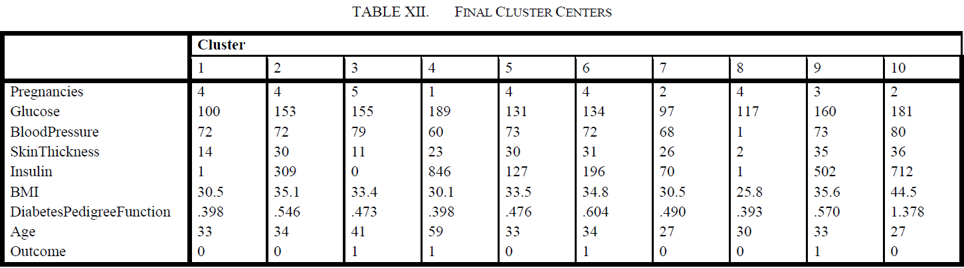
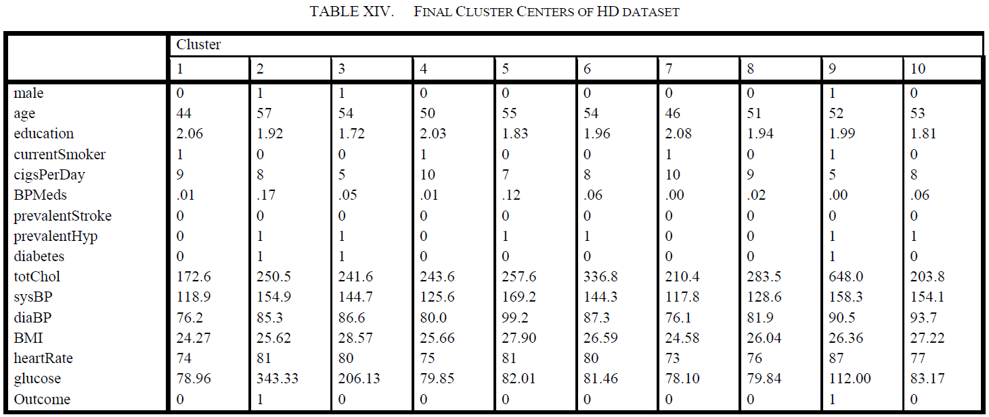
Validation – K means Clustering
Analyzing the data
Validation – K means Clustering
Conclusion

Slide 15
RESULTS :
Results from supervised classification were validated using the un-supervised method
No single method showed better performance in all cases – diabetes and HD dataset.
TABLE XIII :
K means clustering method was applied to the diabetes dataset for identification of cluster characteristics where the outcome is one, i.e., diabetic patients. Table 12 lists the final clusters of diabetes dataset. It shows that blood sugar level of 130 and systolic blood pressure with value greater than 72 and above could suffer from diabetes.
Cluster (3) with highest number of patients show that glucose level of 155 and BP greater that equal to 155 suffer from diabetes.
TABLE XIV:
The HD dataset was subject to K-means clustering to identify the cluster characteristics where the outcome is one, i.e., HD patients. Table 14 lists the final clusters of HD dataset. It shows that even with low value of diastolic blood pressure (85) diabetic patient suffered from HD – cluster 2. Whereas patients with diastolic blood pressure greater than 90 did not suffer from HD as they were non-diabetic.
Analyzing the data
Validation – K means Clustering
Conclusion

Slide 16
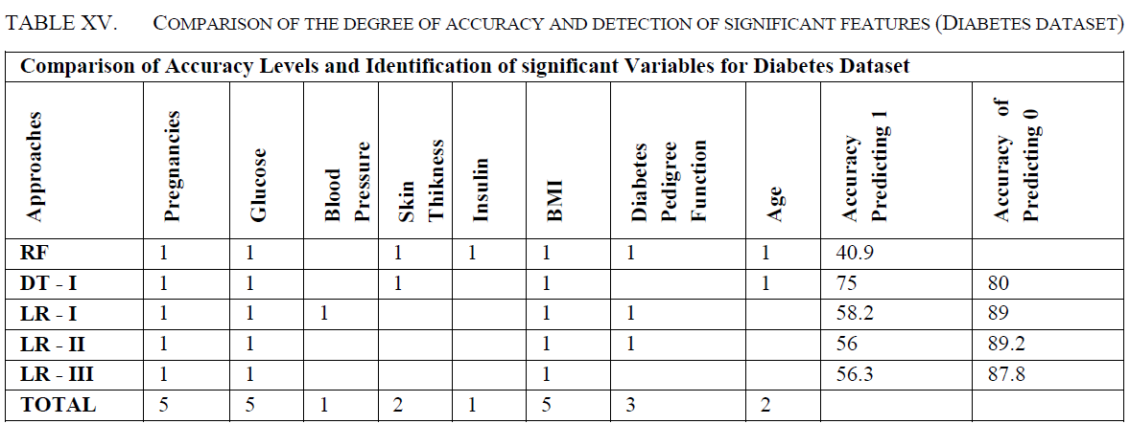
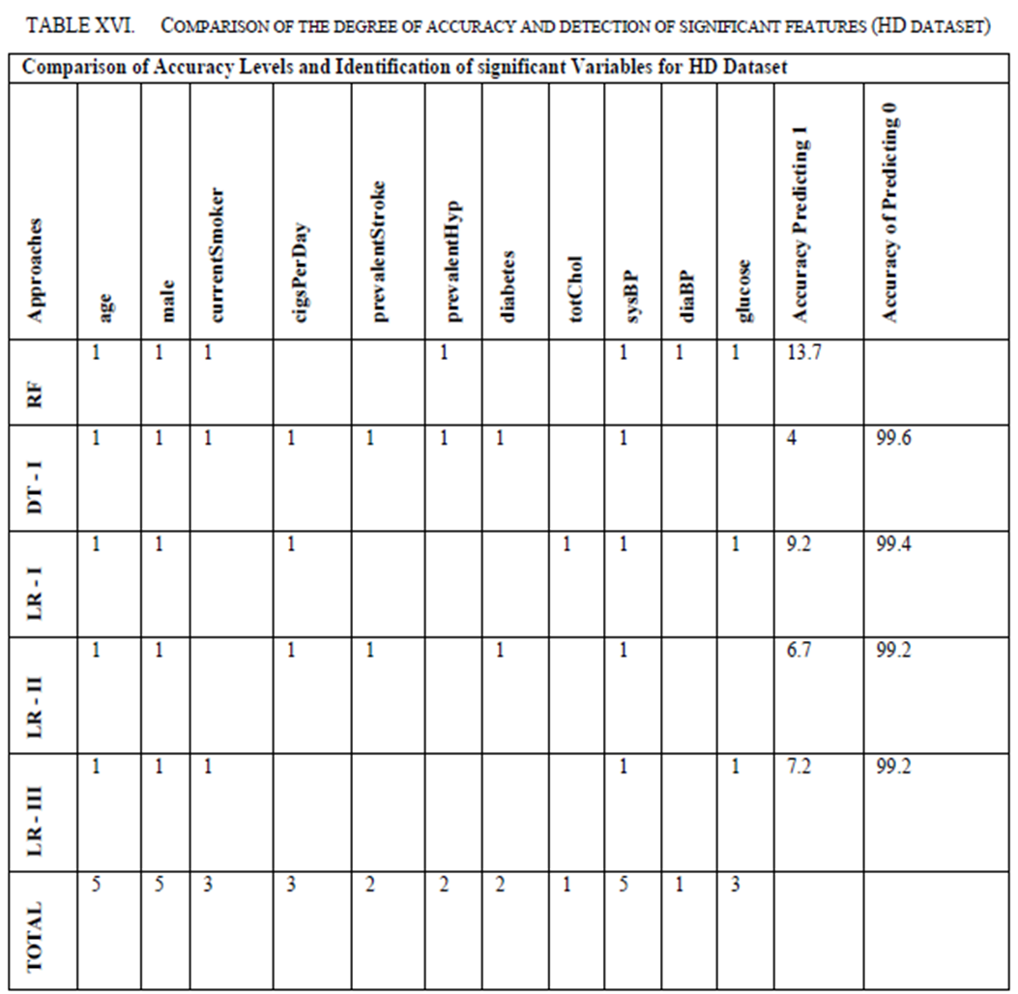
Conclusion
The diabetic patients were primarily affected by t body-mass-index (BMI) followed by pedigree function and then age - shown in table 15.
DT and the ensemble method such as RF showed similar performance in overall accuracy. DT performed better in the diabetes dataset (75% correct prediction with outcome equal to 1) than HD dataset (4% correct prediction with outcome equal to 1).
LR demonstrated better results for diabetes (58% correct prediction with outcome equal to 1) than HD (9% correct prediction with outcome equal to 1).
DT predicted better than any other method, i.e., 13.7% accurate in predicting HD, while RF predicted better than any other method, i.e., 13.7% accurate in predicting diabetes (table 16).
No single method can be recommended in general - a comparative performance always leads to prediction.
Analyzing the data
Validation – K means Clustering
Conclusion

Slide 17

Analyzing the data
Validation – K means Clustering
Conclusion

